Slide 1

Time Values of Notes
Key Question: What do you understand by the term beat or pulse?
A beat or pulse refers to the steady, regular rhythm that acts as the foundation for a piece of music. It is the basic unit of time, similar to a heartbeat, that you can tap your foot or clap along to.
Listen to this small piece of music
and clap what you think is the beat or pulse.

Slide 2
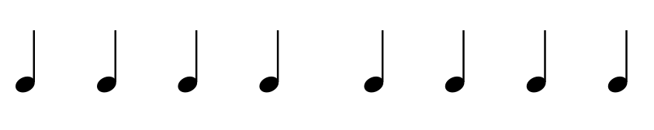
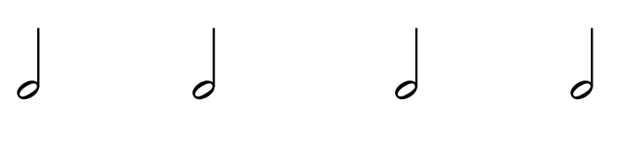
Time Values of Notes
We will be showing beats using a symbol called a crotchet.
Each one of these symbols is equal to one beat.
If a beat is equal to two beats, instead, we use a symbol called a minim.

Slide 3
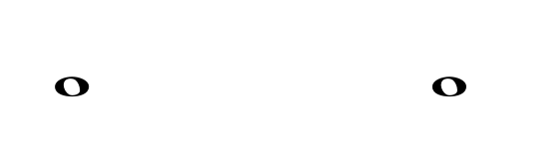
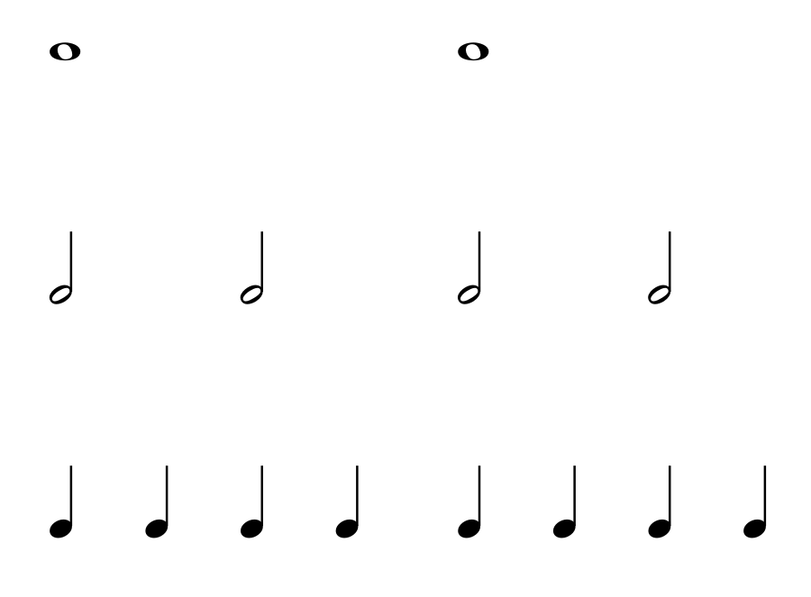
Time Values of Notes
The note that lasts as much as 4 crotchet is called a Semibreve and it is show by this symbol:
The diagram below illustrates the relationship between these notes based on their time values.
Semibreves (Whole Notes)
Minims (Half notes)
Crotechets (Quarter notes

Slide 4
TIME VALUES SONG
Crotchet, crotchet short and sweet
One little beat you tap you feet
Taa, taa minim note,
It takes up two thats what we do
Long note semibreve
It’s all so grand, four whole beats
Long note semibreve
It’s all so grand, let’s sing

Slide 5
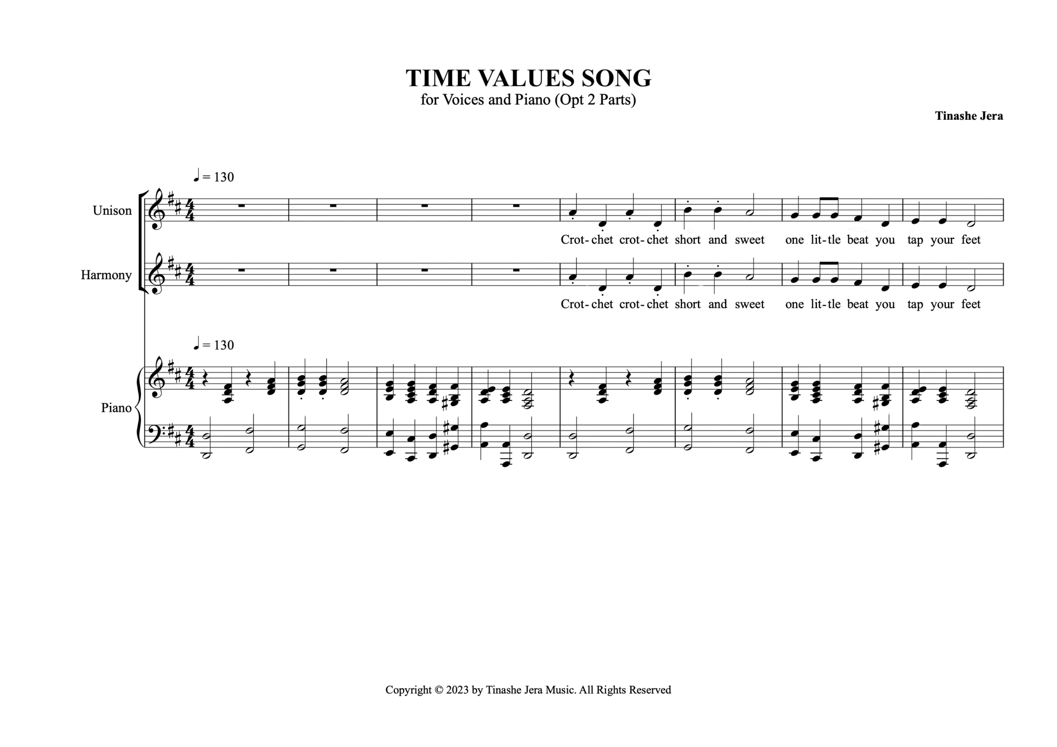
SCORE ANALYSIS
Key Question: Can you name the pointed notes as crotchet, minim or semibreve?
Crotchets
Minims
Crotchets
Minims

Slide 6
Music Bars and Time Signatures
A bar (or measure) is a way of organising notes into small, equal sections to make the music easier to read and play. Each bar contains a set number of beats, which is shown by the time signature at the start of the piece. The bar lines (vertical lines on the staff) divide the music into these sections.
A double bar line shows the end of a piece of music.
A time signature is a symbol at the beginning of a piece of music that tells us how the beats are organized. It has two numbers: the top number shows how many beats there are in each bar, and the bottom number tells us what type of note equals one beat. For example, in a 4/4 time signature, the top number '4' means there are four beats in each bar, and the bottom number '4' means a crotchet (or quarter note) gets one beat.
Time Signature
Bar lines
Double bar line

Slide 7
Key Question
How do time signatures and bar lines help organise music, and how can we use them to create a rhythm?

Slide 8
Quavers and Semiquavers
A quaver or eighth note is half the length of a crotchet (one beat in 4/4 time), so it lasts for half a beat. Two quavers together fill one beat. A semiquaver or sixteenth note is even shorter—it is a quarter of a crotchet, so it lasts for one-quarter of a beat. That means four semiquavers fit into one beat."
Quavers (Eighth Notes)
Semiquavers (Sixteenth Notes
These can also be written with beam lines grouped to match the main beats as follows:

Slide 9
Assessment
Date________________________________
Name_______________________________
Class/Set____________________________
Fill in the Blank: Fill in the blank with the correct words from the word bank below.
1. A _____________ is also known as a sixteenth note.
2. Time signatures are written as a _____________ of two numbers.
3. The _____________ indicates the number of beats in each measure.
4. A _____________ divides the music into measures.
5. A _____________ note is half the duration of a quaver.
Word bank: numerator, bar line, semi-quaver, time signature, semi-breve

Slide 10
Assessment cont.
Multiple Choice Questions:
4. What does a bar line do in sheet music?
○ A) It starts a new line
○ B) It divides music into sections
○ C) It indicates tempo
5. If a time signature is 4/4, how many beats are in each measure?
○ A) 2
○ B) 3
○ C) 4
1. What does a semi-quaver look like?
○ A)
○ B)
○ C)
2. Which number in a time signature indicates the type of note that gets one beat?
○ A) The top number
○ B) The bottom number
○ C) The middle number
3. How many semi-quavers in this note:
○ A) 2
○ B) 4
○ C) 8

